Slide 1
Symmetric key distribution using symmetric encryption
For symmetric encryption to work, the two parties must share the same key, and that key must be protected from access by others
Frequent key changes are usually desirable to limit the amount of data compromised if an attacker learns the key
Therefore, the strength of any cryptographic system rests with the key distribution technique - a term refers to the means of delivering a key to two parties who wish to exchange data without allowing others to see the key
Key distribution between two parties A & B can be achieved as follows:
A can select a key and physically deliver it to B
A third party can select the key and physically deliver it to A and B
If A and B have previously and recently used a key, one party can transmit the new key to the other, encrypted using the old key
If A and B each has an encrypted connection to a third party C, C can deliver a key on the encrypted links to A and B

Slide 2
…Symmetric key distribution using symmetric encryption
Option 1 and 2 call for manual delivery of a key
For link encryption, this is a reasonable requirement, because each link encryption device is going to be exchanging data only with its partner on the other end of the link
Not suitable for end-to-end encryption over network
In a distributed system, any given host or terminal may need to engage in exchanges with many other hosts and terminals over time
Each device needs a number of keys supplied dynamically
If there are N hosts, the number of required keys are [N(N - 1)]/2
Option 3 is a possibility for either link encryption or end-to-end encryption
If an attacker ever succeeds in gaining access to one key, then all subsequent keys will be revealed
the initial distribution of potentially millions of keys still must be made
In option 4 scheme, a key distribution center is responsible for distributing keys to pairs of users (hosts, processes, applications) as needed
Each user must share a unique key with the key distribution center for purposes of key distribution
The use of a key distribution center is based on the use of a hierarchy of keys
At a minimum, two levels of keys are used : session key and master key

Slide 3
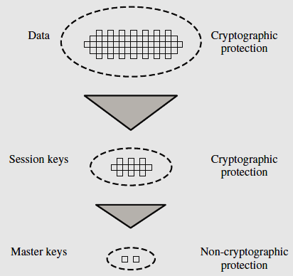
…Symmetric key distribution using symmetric encryption
Communication between end systems is encrypted using a temporary key, often referred to as a session key
Session keys are transmitted in encrypted form, using a master key that is shared by the key distribution center and an end system or user
For each end system or user, there is a unique master key that it shares with the key distribution center

Slide 4
…Symmetric key distribution using symmetric encryption
A Key distribution scenario
Assumes that each user shares a unique master key with the key distribution center (KDC)
user A wishes to establish a logical connection with B and requires a one-time session key to protect the data transmitted over the connection
A has a master key, K_{a}, known only to itself and the KDC; similarly, B shares the master key K_{b} with the KDC

Slide 5
…Symmetric key distribution using symmetric encryption
…A Key distribution scenario : following steps occur
KDC
Initiator A
Responder B
Key Distribution Steps
(1) ID_{A} || ID_{B} || N₁
Auth. Steps
(2) E(K_{a}, [K_{s} || ID_{A} || ID_{B} || N₁]) || E(K_{b}, [K_{s} || ID_{A}])
(3) E(Kb, [Ks || IDA])
(4) E(Ks, N2)
(5) E(Ks, f(N2))

Slide 6
…Symmetric key distribution using symmetric encryption
Hierarchical Key Control
It is not necessary to limit the key distribution function to a single KDC
For very large networks, a hierarchy of KDCs can be established
E.g. local KDCs, responsible for key distribution for a small domain of the overall internetwork, such as a single LAN or a single building
If two entities in different domains desire a shared key, then the corresponding local KDCs can communicate through a global KDC
minimizes the effort involved in master key distribution, because most master keys are shared by a local KDC with its local entities

Slide 7
…Symmetric key distribution using symmetric encryption
Session Key Lifetime
The more frequently session keys are exchanged, the more secure they are - opponent has less ciphertext to work with for any given session key
the distribution of session keys delays the start of any exchange and places a burden on network capacity
A security manager must try to balance the competing considerations
For connection-oriented protocols, use a new session key for each new session
For connection less protocol (i.e. transaction-oriented protocol), the most secure approach is to use a new session key for each exchange
A better strategy is to use a given session key for a certain fixed period only or for a certain number of transactions

Slide 8
…Symmetric key distribution using symmetric encryption
A Transparent Key Control Scheme
The scheme is useful for providing end-to-end encryption at a network or transport level
The steps involved in establishing a connection are
Host sends packet requesting connection
Session Security Module (SSM) buffers packets; asks KDC for session key
KDC distributes session key to both hosts
Buffered packets transmitted

Slide 9
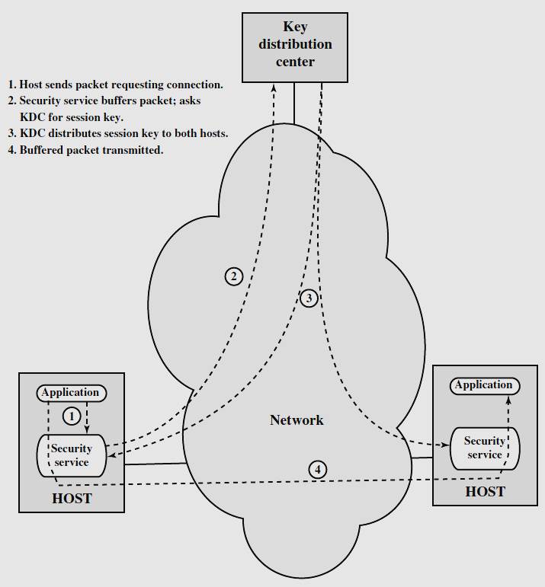

Slide 10
Symmetric key distribution using symmetric encryption
Decentralized Key Control
Key distribution center imposes the requirement that the KDC be trusted and be protected from subversion
This can be avoided if key distribution is fully decentralized
Each end system be able to communicate in a secure manner with all potential partner end systems
[n(n - 1)]/2 master keys for a configuration with ‘n’ end systems

Slide 11
…Symmetric key distribution using symmetric encryption
…Decentralized Key Control : A session key may be established with the following sequence of steps
(1) ID_{A} || N₁
Initiator
A
Responder
B
(2) E(K_{m} , [K_{s} || ID_{A} || ID_{B} || f(N₁) || N₂ ])
(3) E(K_{s} , f(N₂))

Slide 12
Symmetric key distribution using Asymmetric encryption
One of the most important uses of a public-key cryptosystem is to encrypt secret keys for distribution
Simple Secret Key Distribution
If A wishes to communicate with B, the following figure depicts the same
(1) ID_{A} || PU_{A}
A
B
(2) E( PU_{A} , K_{S} )

Slide 13
…Symmetric key distribution using Asymmetric encryption
…Simple Secret Key Distribution
The risk of compromise of the keys is minimal. At the same time, the communication is secure from eavesdropping
Man-in-the-Middle Attack: Insecure against an adversary who can intercept messages and then either relay the intercepted message or substitute another message
An adversary, D, has control of the intervening communication channel, then D can compromise the communication without being detected

Slide 14
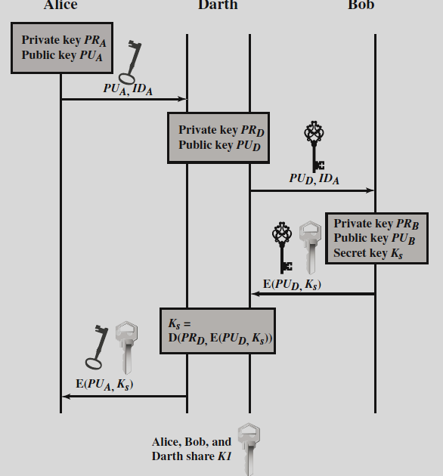

Man-in-the-Middle Attack
The result is that both Alice and Bob know K_{s} and are unaware that K_{s} has also been revealed to Darth
Only threat is eavesdropping

Slide 15
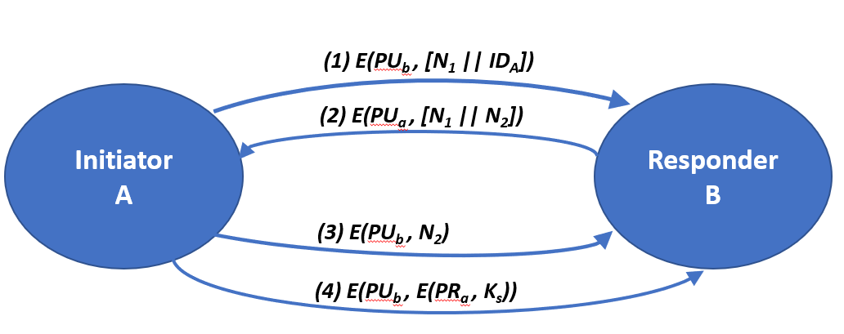
…Symmetric key distribution using Asymmetric encryption
Secret Key Distribution with Confidentiality and Authentication
Provides protection against both active and passive attacks
It is assumed that A and B have exchanged public keys
This scheme ensures both confidentiality and authentication in the exchange of a secret key
Next slide shows the steps involved in this scheme

Slide 16
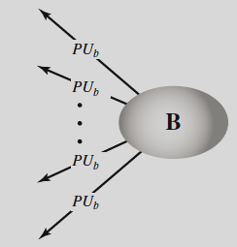
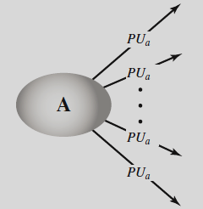
Distribution of Public Keys
General Schemes
Public announcement
Publicly available directory
Public-key authority
Public-key certificates
Public announcement of Public keys
This approach is convenient - Major weakness: Anyone can forge such a public announcement

Slide 17
…Distribution of Public Keys
Publicly Available Directory
A greater degree of security can be achieved by maintaining a publicly available dynamic directory of public keys
Maintenance and distribution of the public directory :be the responsibility of some trusted entity or organization
Elements :
The authority maintains a directory with a {name, public key} entry for each participant
Each participant registers a public key with the directory authority
A participant may replace the existing key with a new one at any time
Participants could also access the directory electronically

Slide 18
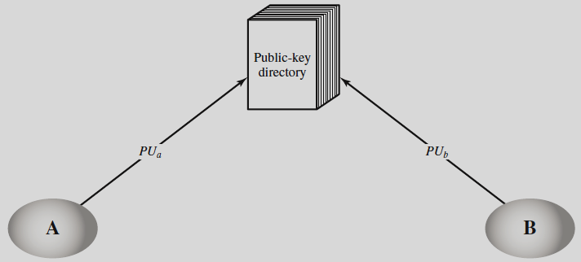
…Distribution of Public Keys
Vulnerabilities: an adversary succeeds in obtaining or computing the private key of the directory authority ; adversary could authoritatively pass out counterfeit public keys and subsequently impersonate any participant and eavesdrop on messages sent to any participant

Slide 19
…Distribution of Public Keys
Public-Key Authority
Stronger security for public-key distribution can be achieved by providing tighter control over the distribution of public keys from the directory
each participant reliably knows a public key for the authority, with only the authority knowing the corresponding private key
Next slide shows the steps involved in this scheme

Slide 20




…Distribution of Public Keys
Initiator A
Pub. Key Authority
Responder B
Initial five messages used infrequently – Both A & B can save other’s public key for future use – Caching Technique

Slide 21
…Distribution of Public Keys
Public-Key Certificates
Previous scheme has some drawbacks: The Public-key authority could be a bottleneck in the scheme; user must appeal to the authority for a public key and it is vulnerable to tampering
An alternative approach : use certificates – can be used by participants to exchange keys without contacting a public-key authority
A certificate consists of a public key, an identifier of the key owner, and the whole block signed by a trusted third party

Slide 22
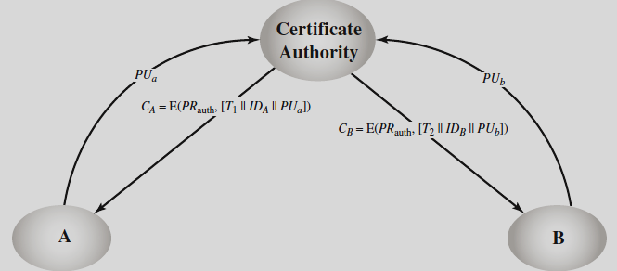
…Distribution of Public Keys
Obtaining Certificates from Certificate Authority (CA)

Slide 23
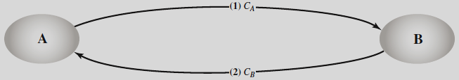
…Distribution of Public Keys
Exchanging Certificates
The timestamp serves as an expiration date
If a certificate is sufficiently old, it is assumed to be expired
One scheme has become universally accepted for formatting public-key certificates: the X.509 standard

Slide 24
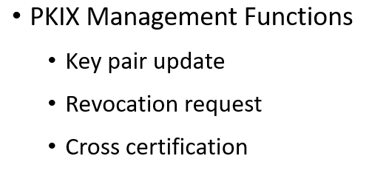
Public-Key Infrastructure (PKI)
RFC 4949 (Internet Security Glossary) defines public-key infrastructure (PKI) as the set of hardware, software, people, policies, and procedures needed to create, manage, store, distribute, and revoke digital certificates based on asymmetric cryptography
The principal objective for developing a PKI is to enable secure, convenient, and efficient acquisition of public keys
Interrelationship among the key elements of the PKIX model
End entity
Certification Authority (CA)
Interrelationship among the key elements of the PKIX model
Registration Authority (RA)
CRL issuer
Repository
PKIX Management Functions
Registration
Initialization
Certification
Key pair recovery

